Slide 1

Project Final 16ECPB005 Weather Prediction and Forecasting
Karnatak Law Society’s
Gogte Institute Of Technology, Belagavi
By
MIHIKA MALGI (2GI16EC075 )
MOHAMMADFAIZ BAWA (2GI16EC078 )
POONAM PATIL (2GI16EC101)
PRIYA SHETTI (2GI16EC109 )
Under The Guidance Of Co-Guide
DR.VEENA DESAI Prof. Pratijnya Ajwain
(Professor –Dept of EC) (Asst. Prof – Dept of EC)

Slide 2
Introduction
Weather is one of the most important event that affects the human life in every dimension, ranging from food to fly. While on the other hand it is the most disastrous phenomena. Therefore, prediction of weather phenomena is so important to avoid destruction of weather hazards.
Weather forecasting is mainly concerned with the prediction of weather condition in the given future time.
The prediction of weather condition is essential for various applications
( climate monitoring, drought detection etc).
NOTE: Accurate prediction of weather is a difficult task due to the dynamic nature of atmosphere.

Slide 3
Literature survey
“Weather prediction using machine learning techniques” is carried out by Sahil Ratra Under the supervision of Dr. Amit Kumar. There are numerous kinds of machine learning calculations. These research explains about accuracy machine learning algorithms and the reasons behind them. Among all Multiple regression model has high variance and Random Forest was the one with the maximum accuracy.
“A Weather Forecasting Model using the Data Mining Technique” The weather conditions are changing continuously and the entire world is suffering from the changing Climate and their side effects. Therefore, pattern on changing weather conditions are required to observe.
“Weather Prediction: A novel approach for measuring and analyzing weather data”.Weather prediction is the application of technology to predict the weather for a given location based on historical data or current data as applicable

Slide 4
Problem Statement:
To provide an area specific weather forecast and analysis for the future conditions. The main focus being on agricultural and area management tool for the region. Thus, the aim is to understand and develop such effective system.
Objectives:
The main objective is to predict the change in weather using past weather datasets.
This project aims to estimate the weather by utilizing predictive analysis.
This proposed application is helpful for various sectors like agriculture, horticulture and domestic use.
To alert identified regions for change in weather conditions to take preventive measures.
The designed application will be helpful in different sectors like agriculture, horticulture, poultry farming etc.

Slide 5
Methodology
First a dataset is retrieved from WorldWeatherOnline website which is used In the code for training and predictions.
This dataset contains the 3 years of weather data with 3hour frequency including parameters like pressure, humidity, windspeed, precipitation etc.
After data mining and data filtering, the remaining parameters will be used to train and predict the temperature.
Then the Random forest Regression algorithm is used to predict the weather. Because Random forest algorithm gives highest accuracy among all machine learning algorithms i.e. 99.7% accuracy.
Then Random forest regression is then analyzed on Jupyter notebook.
The present code used in this project can predict weather data with 3hours frequency.
After successful prediction of temperature by using Random forest Regression, the code will be interrogated with the GUI.
Tktinter library is used to develop GUI application.

Slide 6
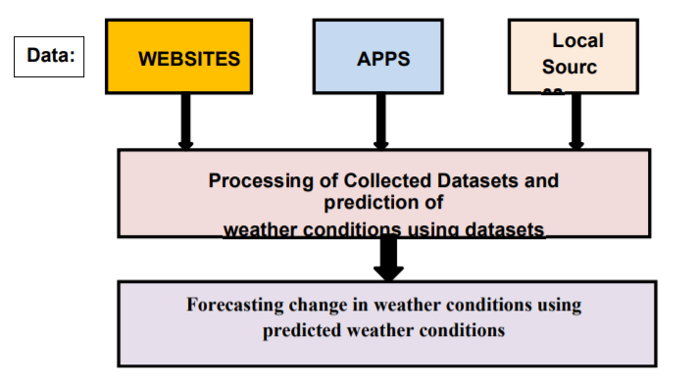
Block Diagram

Slide 7
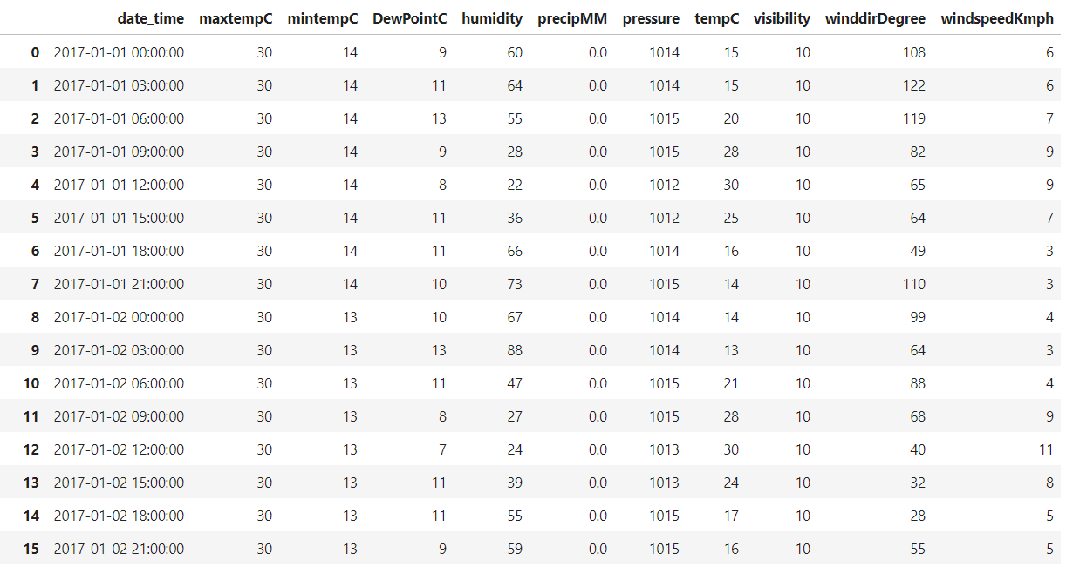
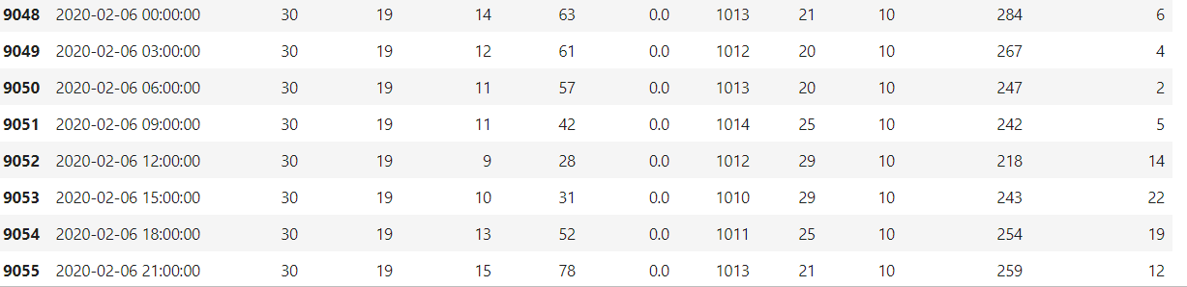
Weather Dataset collected for Belgaum

Slide 8

Random Forest Algorithm
Method that operates by constructing multiple decision trees.
Decision of majority trees is the final decision.

Slide 9
GUI Application – Tkinter Library
Tkinter Library :
Tkinter is the standard GUI library for Python.When it is combined with python it provides a fast and easy way to create GUI applications and it also a powerful object-oriented interface to the Tk GUI toolkit.
It provides 15 types of widgets(button,label,text boxes etc) and these are easy to use.
All Tkinter widgets have access to specific geometry management methods, which have the purpose of organizing widgets throughout the parent widget area.
For example pack() and grid() methods which organizes the widgets in blocks and in table like structures respectively.

Slide 10
Working
Our project aim to collect the previous dated datasets and using machine learning techniques to predict the future weather data.
As we have used random forest machine learning algorithm for prediction which is the combination of two decision tree algorithms which is making decisions and categorizing the behavior of situations based on the decisions made.
Random forest algorithm basically (multiple decision tree algorithms) works on probability concept as the decision tree value which has more probability of occurrence is the final predicted value.

Slide 11
Merits and Demerits
Merits:
Used to predict the weather conditions prior and take needful actions
Helps to avoid future destructions.
Demerits:
Imperfect datasets
Depends on accuracy as all predictions are not 100% accurate.

Slide 12
Applications
Agriculture Sectors
Disastrous Areas
Marine
Air Traffic
Military applications
Utility companies.

Slide 13
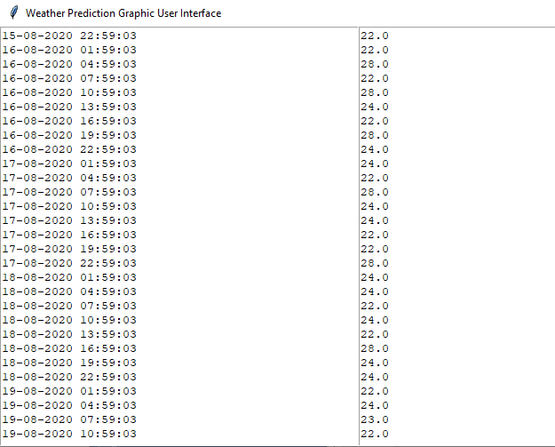
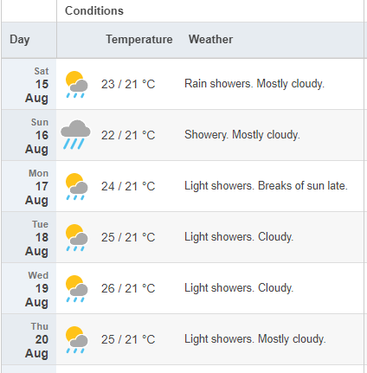
Results - GUI
ACTUAL PREDICTED DATA FROM INTERNET
OUR PREDICTED DATA - GUI

Slide 14
Conclusion
The analysis based on weather prediction is performed, where the algorithm is being analyzed for weather prediction using random forest algorithm on Jupyter notebook anaconda, which be the suited for the surrounding environment with the best of monitoring network.
The goal of this work is to design a code for training and testing weather previous dataset to predict weather.
The system sets an example on how to predict weather which can be used at domestic and commercial places with future vision.

Slide 15
References
[1] Ratra, S. and Kumar, A., 2019. Weather Prediction using Machine Learning Techniques.
[2] Yadav, R.K. and Khatri, R., 2016. A Weather Forecasting Model using the Data Mining Technique. International Journal of Computer Applications, 139(14).

Slide 16
THANK YOU

